Slide 1
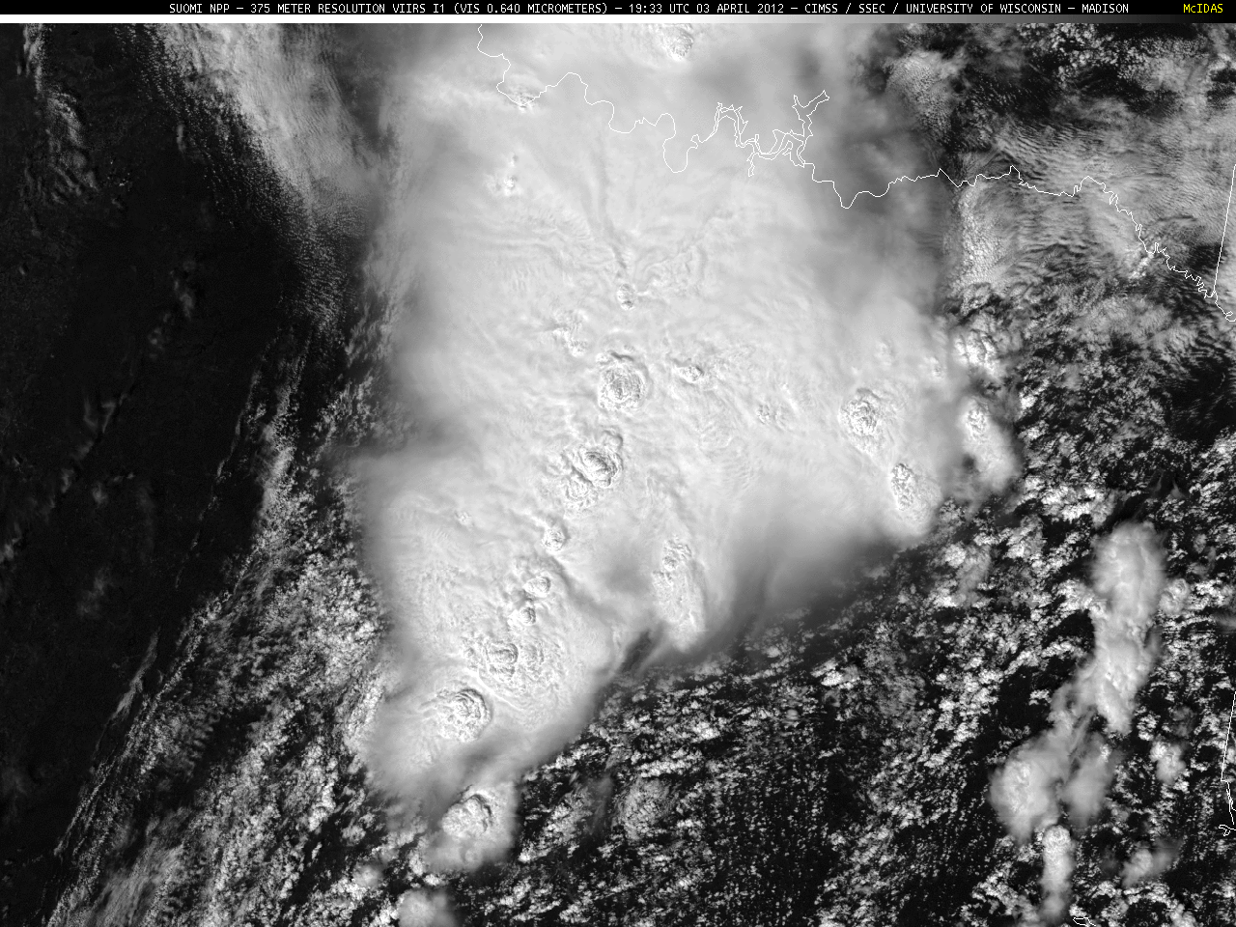
Use of s-npp in noaa national weather service operations
Michael J. Folmer
(UMCP/ESSIC/CICS)
Satellite Liaison at OPC/SAB/TAFB/WPC
Contributions:
Amanda Terborg (CIMSS/AWC), Emily Berndt (SPoRT), and Kathy Strabala (CIMSS)
2nd S-NPP Applications Workshop
11/20/14
1

Slide 2
Getting Polar-Orbiting Products into Operations at NCEP National Centers
Prior to the Satellite Proving Ground (GOES-R and JPSS), many polar-orbiting products were introduced to operations
Scatterometers
Altimeters
The Satellite Proving Ground helped introduce more imagery and products
S-NPP VIIRS into operations around the time of Hurricane Sandy (October 2012 – SPoRT/CIMSS)
MODIS imagery to introduce RGBs (SPoRT/CIRA)
Passive Microwave Imagery (SPoRT/NRL)

Slide 3
NOAA/NWS Marine Responsibility
High Seas - HSF
Offshore - OFF
Coastal - CWF
WARNINGS Hurricane Force
Storm
Gale
METAREA XII
METAREA IV
METAREA XVI
Notes:
NOAA / National Weather Service has three tiers of marine warning and forecast responsibility:
HIGH SEAS – (RED) GMDSS requirement for METAREAs IV, XII, XVI and adjacent waters
OFFSHORE – (yellow) waters to EEZ and beyond Coastal waters – with the COASTAL: waters meets GMDSS NAVTEX requirement.
COASTAL Waters – (light blue) on average within 60 n mi of coast and includes bays, rivers, estuaries, and Lakes.
COASTAL and OFFSHORE Zones are not just over the Atlantic and Pacific basins but include all the challenges of the Chukchi and Beaufort Seas. A location void of conventional observations and only served presently by the CryoSat altimeter and ASCAT and OSCAT scatterometers for winds and waves.

Slide 4
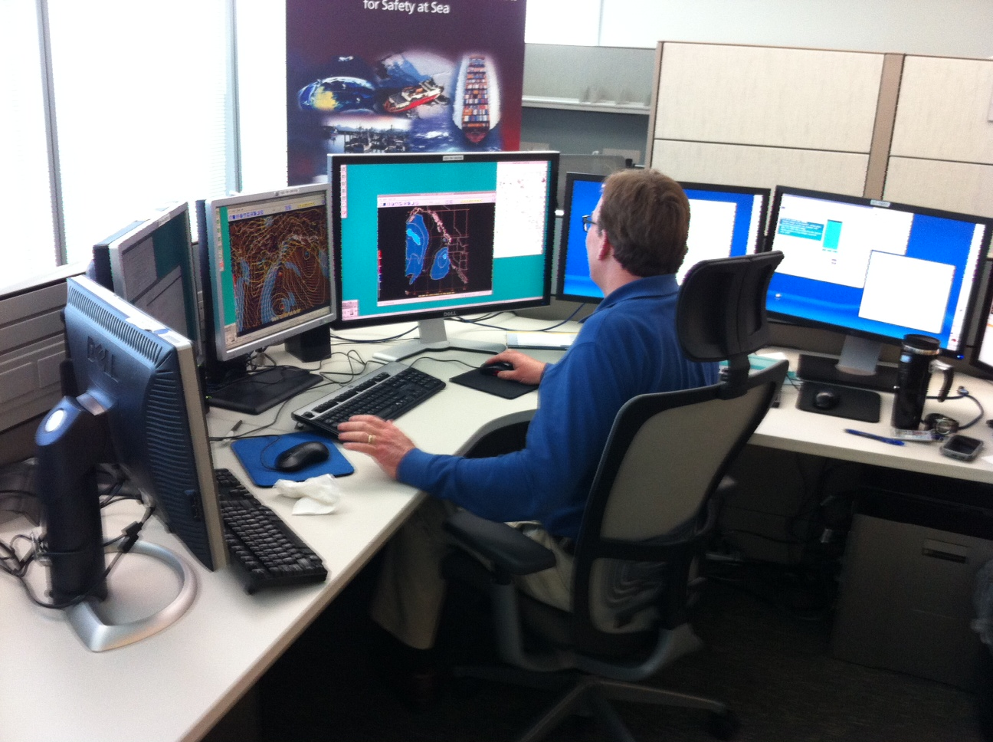
My Cube

Slide 5
How were satellites used prior to the proving grounds?
Geostationary
Scatterometers
Altimeters

Slide 6
March 6 & 7, 2013 Nor’easter GOES-13 WV overlaid with WPC sfc analyses

Slide 7
March 6 & 7, 2013 Nor’easter Blended Total Precipitable Water Percent of Normal

Slide 8
Medium Range Forecast Issues Spaghetti Plot of the 564 DM Height Line
Courtesy of Michael Schichtel (WPC)

Slide 9
Satellite Observations vs. Model Forecasts GFS and ECMWF 500 mb Heights overlaid on WV

Slide 10
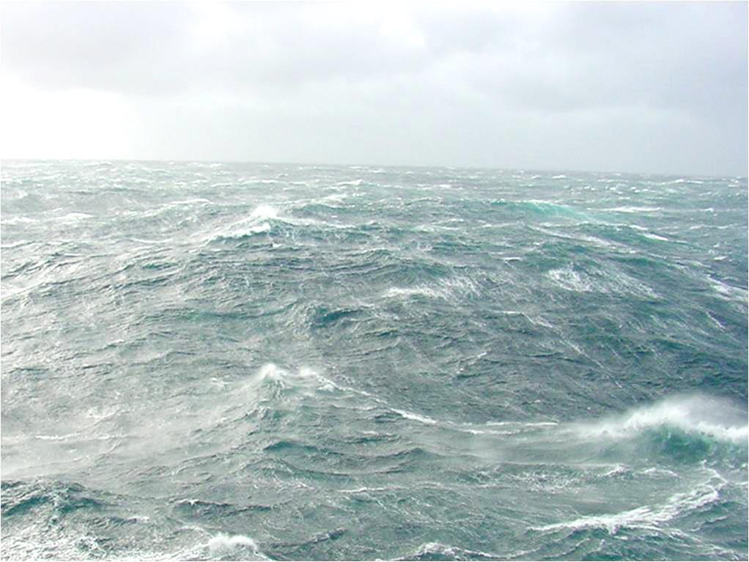
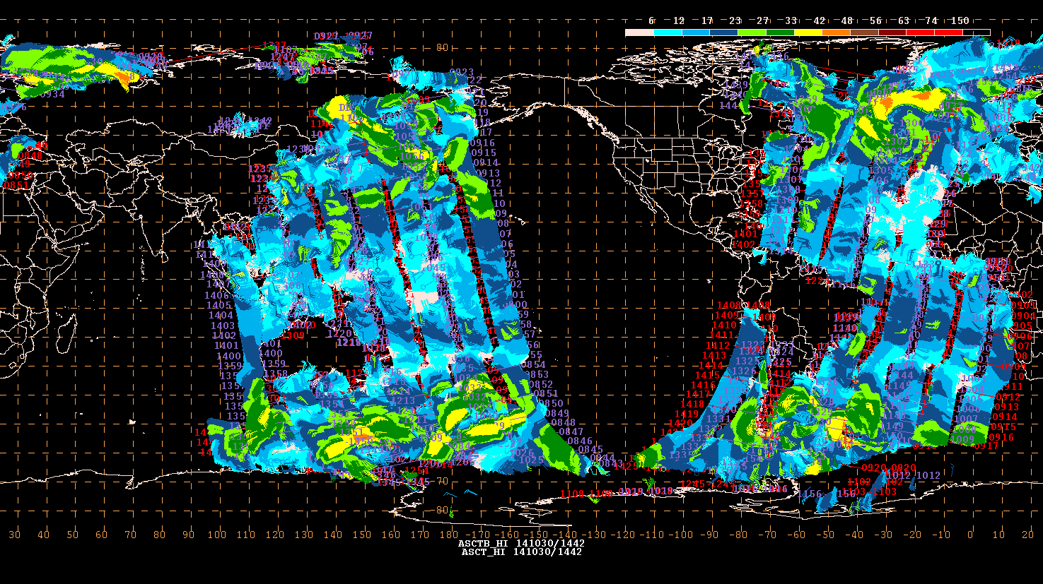
OPC Activities Ocean Winds ASCAT A & B

Slide 11
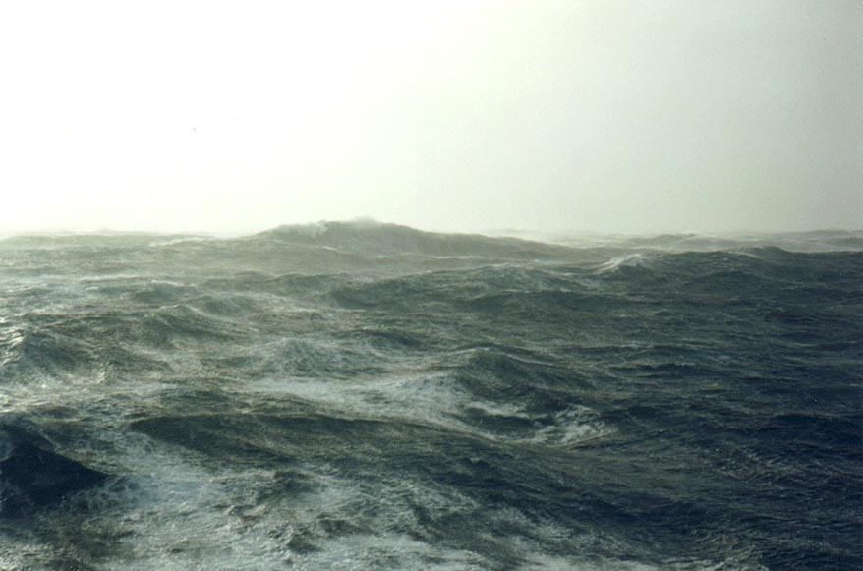
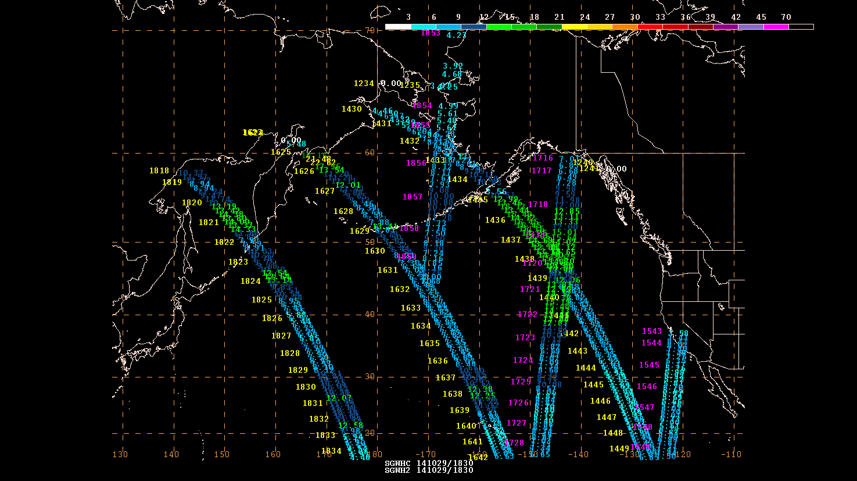
OPC Activities Ocean Waves
Jason-2 and Cryosat

Slide 12
S-npp products introduced through the satellite proving grounds
VIIRS, CrIS, ATMS – OPC, SAB, NHC, WPC
VIIRS – AWC
VIIRS, CrIS – a few NWS WFOs
Future VIIRS, CrIS products at SPC

Slide 13
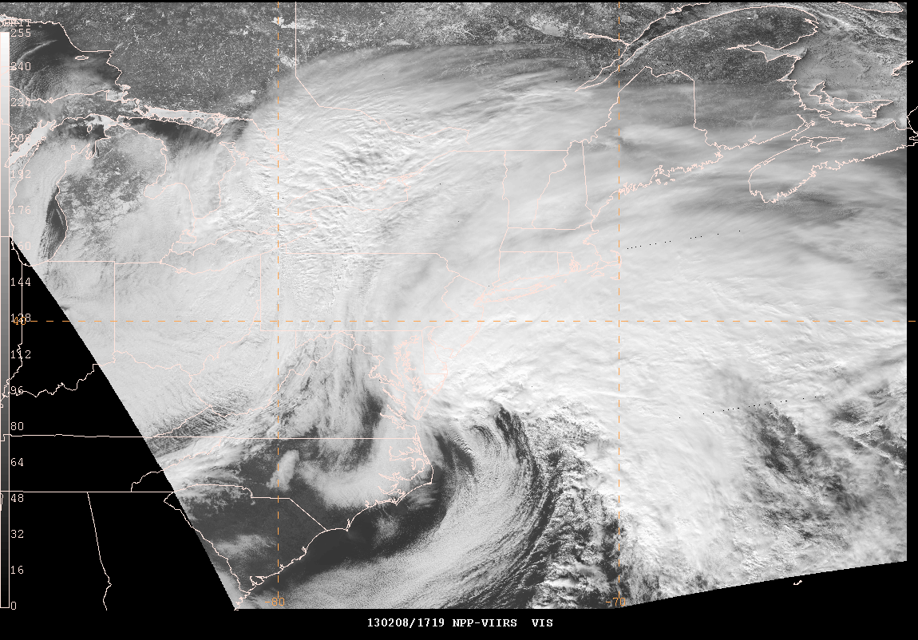
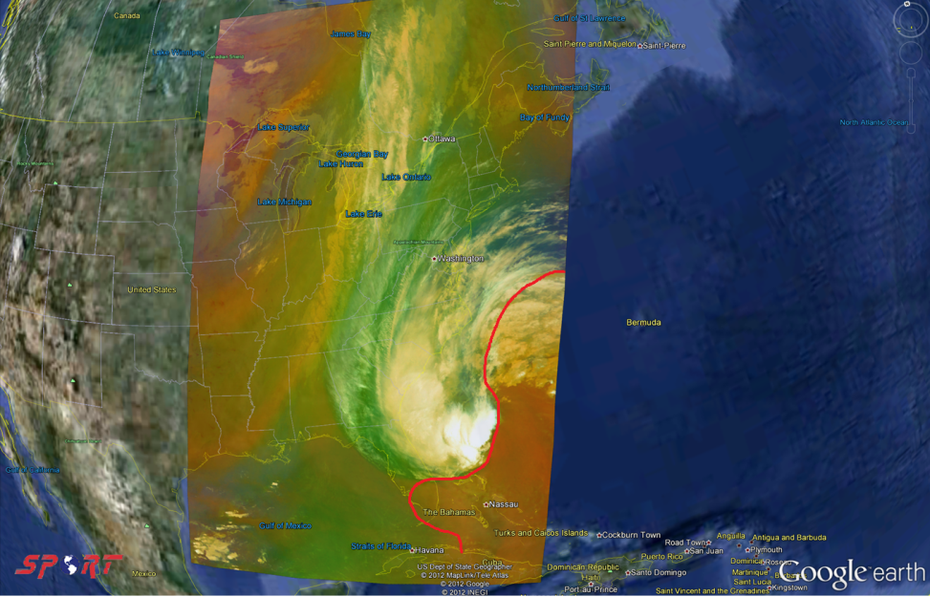
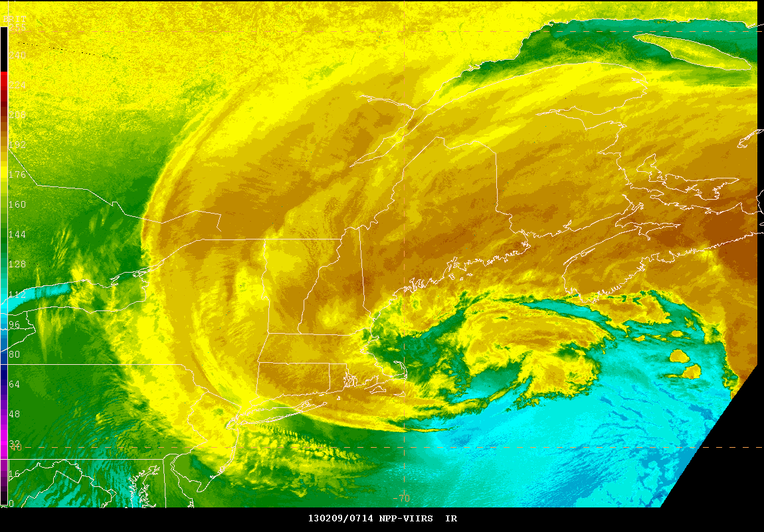
Suomi NPP VIIRS Imagery Provided by CIMSS and NASA SPoRT
VIIRS Visible
VIIRS/CrIS RGB Air Mass
VIIRS Longwave IR
VIIRS Day-Night Band

Slide 14
Day-Night Band Used by WPC and OPC to monitor cold front and storms at night with moonlight!
CONUS
ALASKA
Courtesy of CIMSS and NASA SPoRT

Slide 15
Day-Night Band Unique use at WPC and SAB Coupled with the Overshooting Top Detection (Bedka)
VIIRS LWIR and OTD
VIIRS dnb and otd
Courtesy of CIMSS and NASA SPoRT

Slide 16
Dust Storm on 04/17/2013 VIIRS RGB Dust Product
Courtesy of CIMSS and NASA SPoRT

Slide 17
Hurricane Manuel (2013) First DNB image in NHC N-AWIPS workstations
Courtesy of CIMSS and NASA SPoRT

Slide 18
Super Typhoon Vongfong (2014) ATMS 88GHz “V”
Courtesy of NASA SPoRT and NRL

Slide 19
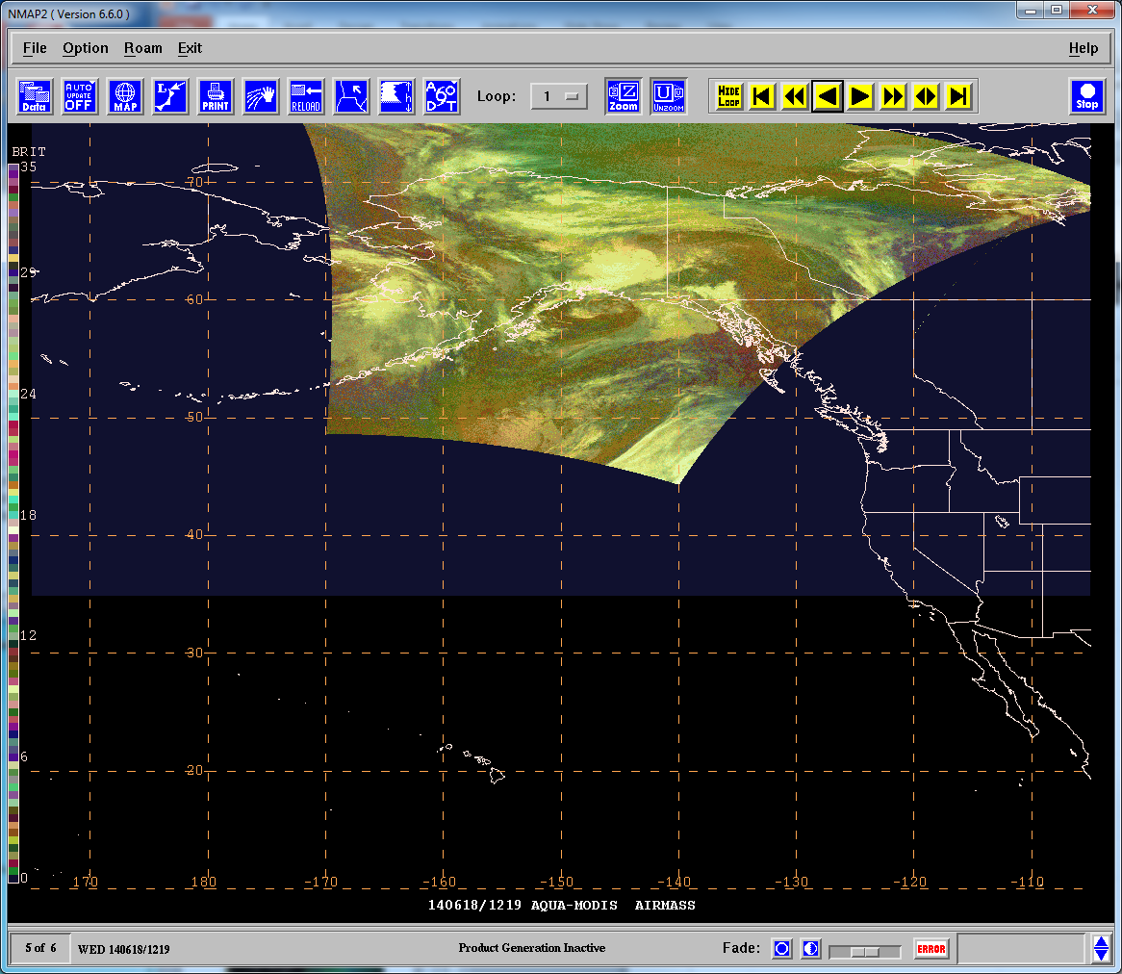
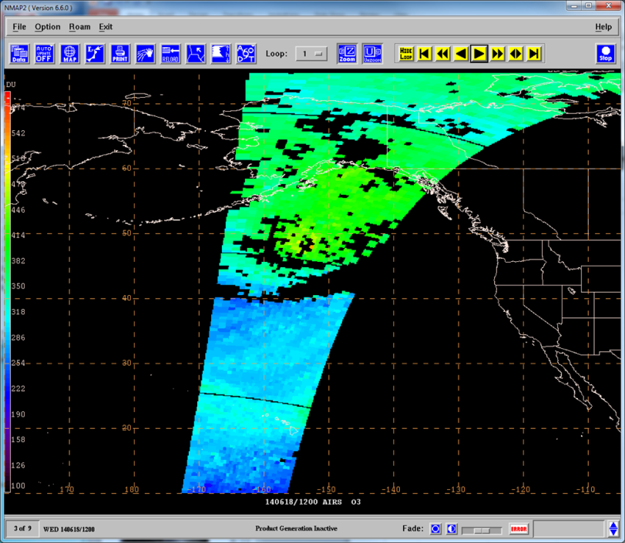
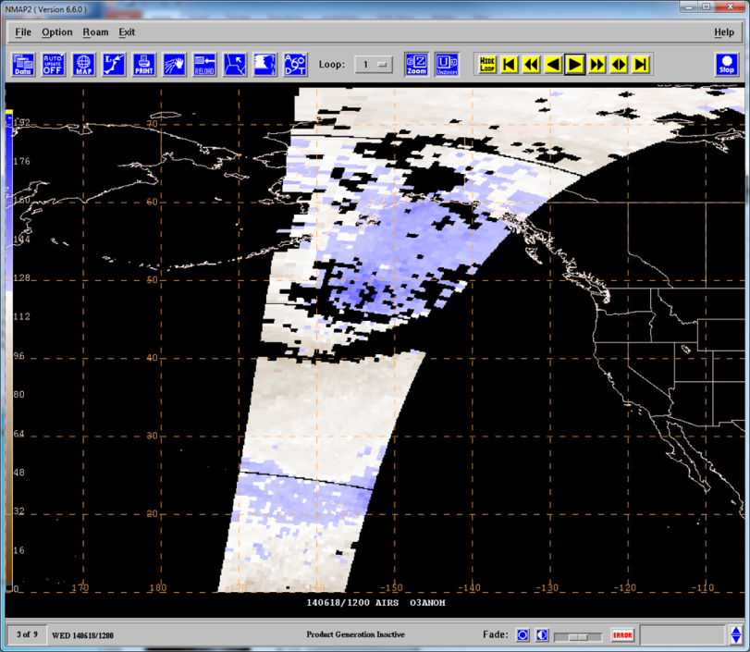
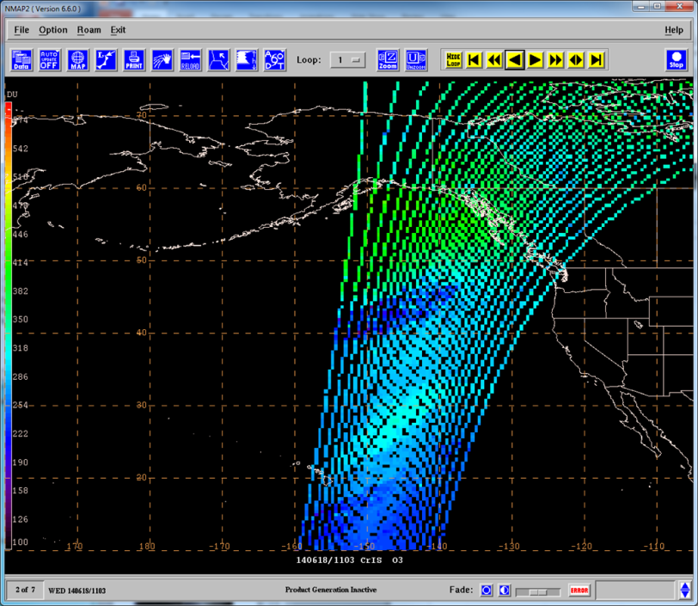
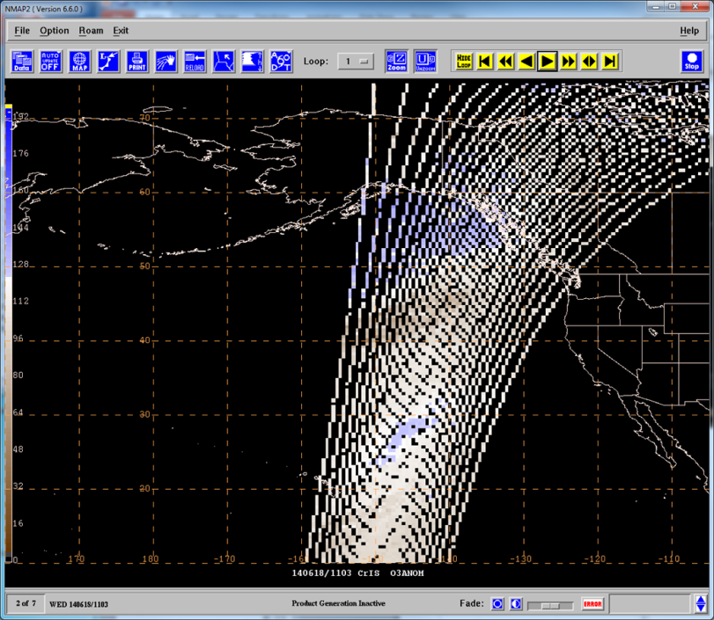
SPoRT CrIS Ozone Products
1219 UTC
1200 UTC
1200 UTC
MODIS RGB Air Mass 19 June 2014
AIRS Total Column O3 19 June 2014
AIRS O3 Anomaly 19 June 2014
Forecaster use ozone products to gain confidence in Air Mass RGB for identifying stratospheric air
Initial development with CrIMSS but no longer supported
NUCAPS products coming soon
1100 UTC
1100 UTC
CrIMSS Total Column O3 19 June 2014
CrIMSS O3 Anomaly 19 June 2014

Slide 20
Arctic Imagery 4 km Infrared Geo/Leo Blend
Courtesy of Matthew Lazarra (CIMSS/SSEC)

Slide 21
SPoRT GOES-13 Hybrid Product 4 km Infrared Geo/Leo Blend
Courtesy of Matt Smith (SPoRT)

Slide 22
SPoRT GOES-13 Hybrid Product 4 km Infrared Geo/Leo Blend
Courtesy of Matt Smith (SPoRT)

Slide 23
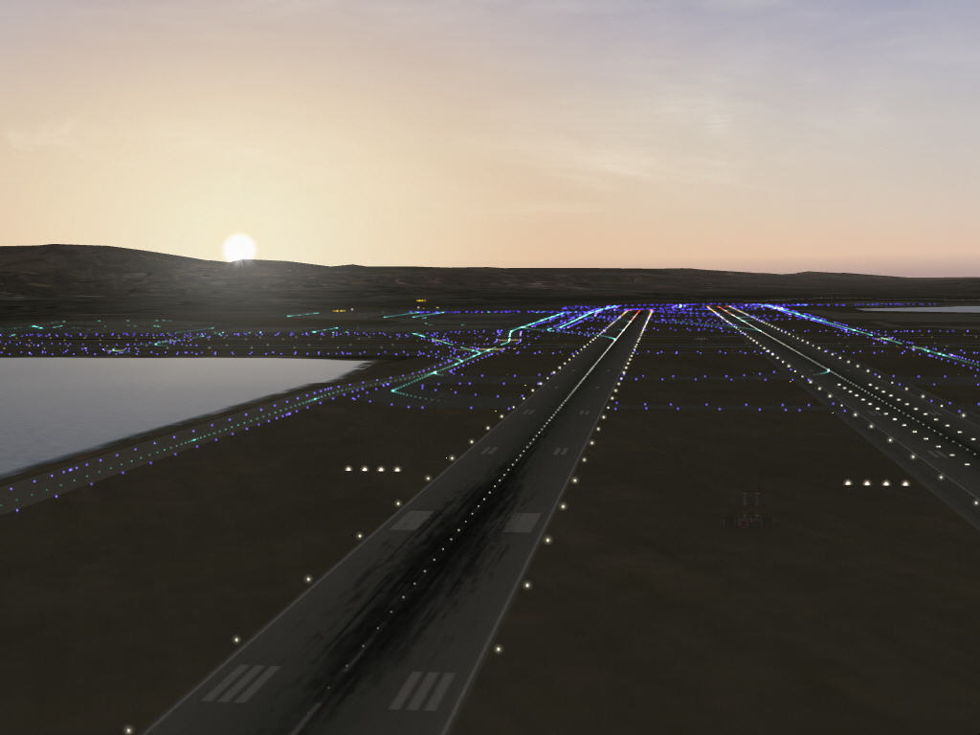
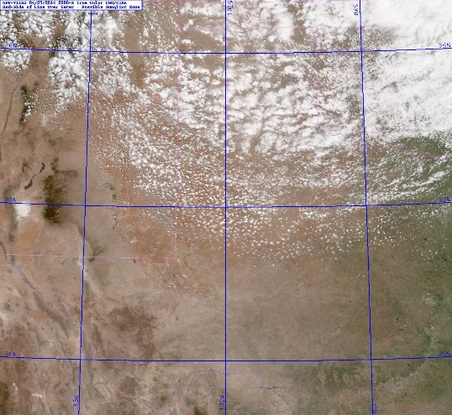
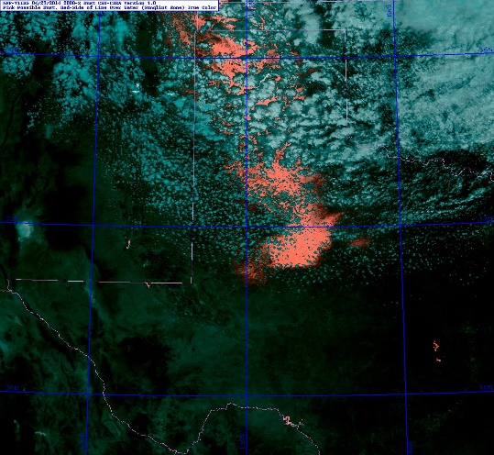
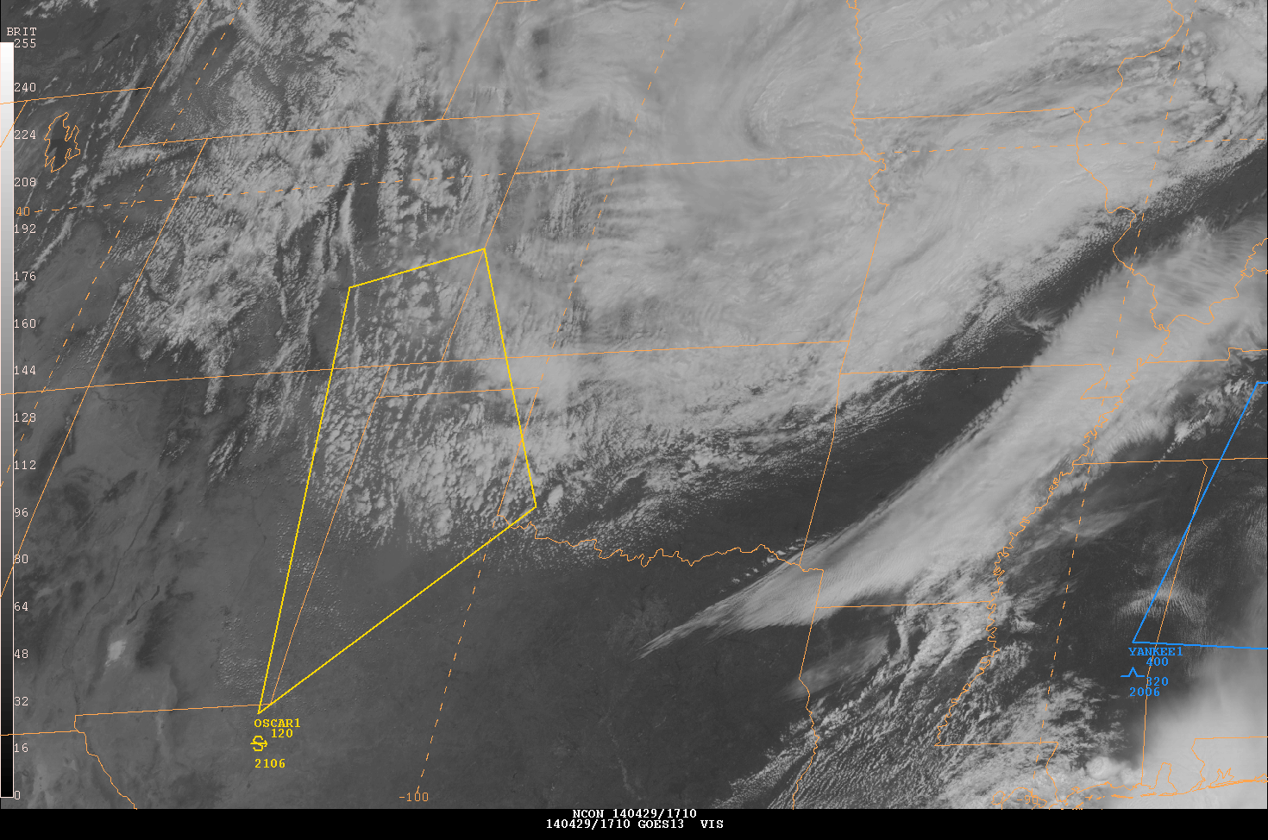
NPP at the Aviation Weather Center
Night microphysics
Explored for use in the tropical forecasting domain
EUMETSAT dust (from SPoRT)
Looked at for decision support in issuing blowing dust SIGMETS, but color-blindness issues of the forecaster prevented any real use
Dust enhancement (from CIRA)
Used for decision support in issuing blowing dust SIGMETS on April 29th, 2014

Slide 24
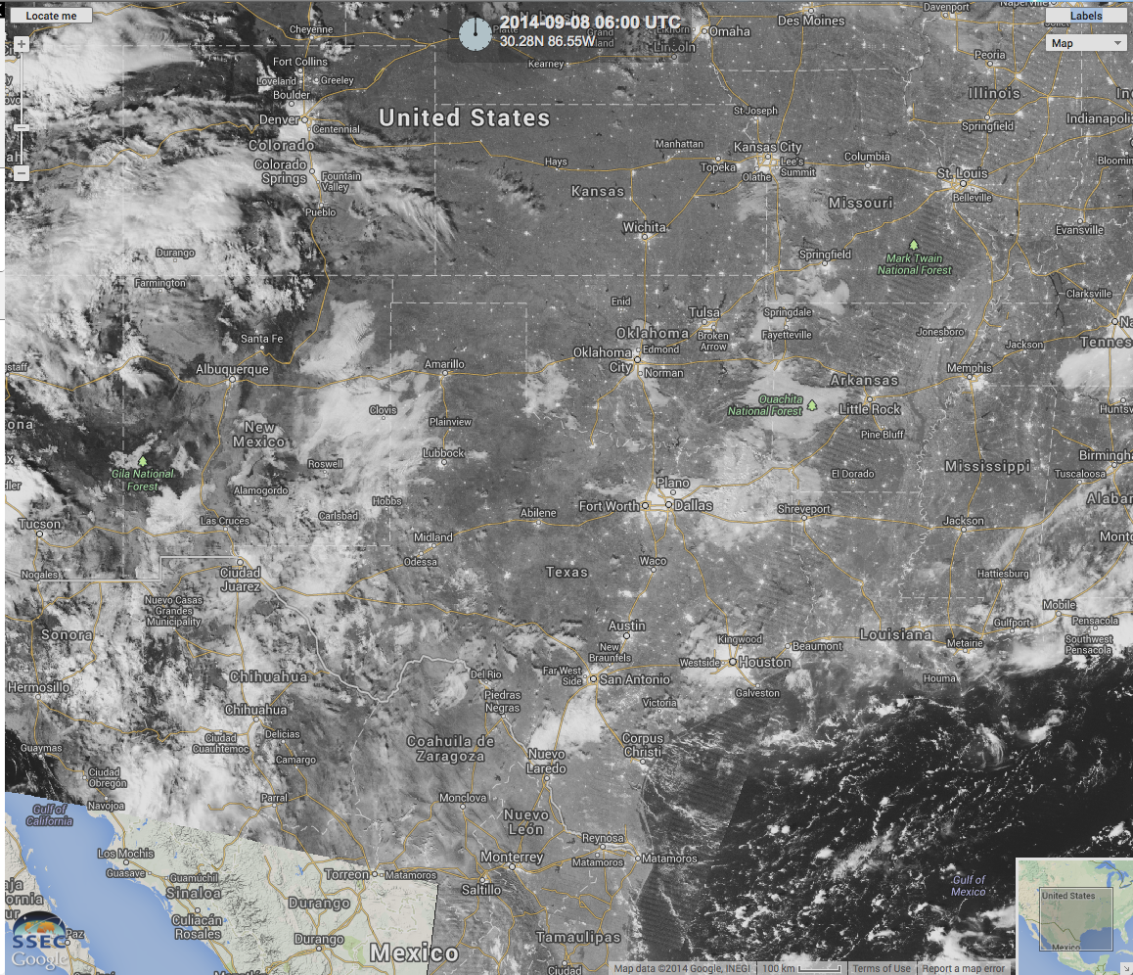
Assisting with Convection Forecasts
AREA FORECAST DISCUSSION NATIONAL WEATHER SERVICE BROWNSVILLE TX 359 AM CDT MON SEP 8 2014
.SHORT TERM /NOW THROUGH TUESDAY/...MAIN FORECAST ISSUE TODAY WILL BE HOW MUCH DRY AIR WILL ARRIVE ALOFT AND HOW MUCH THIS WILL INHIBIT CONVECTION. SOUNDING FROM LAST EVENING SHOWED PW VALUE OF 2.09 AS LOW T-TD DEPRESSION CONTINUED FROM NEAR THE SFC UP TO 20000 FEET. SUOMI VIIRS DAY/NIGHT IMAGERY SHOWS SKIES REMAINING MOSTLY CLEAR WHILE STREAMER SHOWERS BUILDING WELL TO THE SOUTH AND SOUTHEAST. GOES PW IMAGERY SHOWS POCKET OF DRIER AIR MOVING INLAND ACROSS SOUTH TEXAS THIS ATTM. MODEL DATA SHOWS THIS DRY AIR ABOVE 10000 FEET SHOULD SLOWLY INCREASE TODAY...SLOWLY DECREASING THE CONVECTIVE CHANCES THROUGH THE AFTERNOON. WILL HOLD ON TO 20 POPS FOR ISOLATED CONVECTION ACROSS THE IMMEDIATE COASTAL AREAS LATE THIS MORNING...AND REACHING INLAND AS FAR AS KMFE LATER THIS AFTERNOON BEFORE THE DRIER AIR TAKES OVER. DRIER AIR CONTINUES TO INCREASE TONIGHT INTO TUESDAY...WITH MINIMAL CHANCE FOR ANY CONVECTION TO OCCUR.

Slide 25
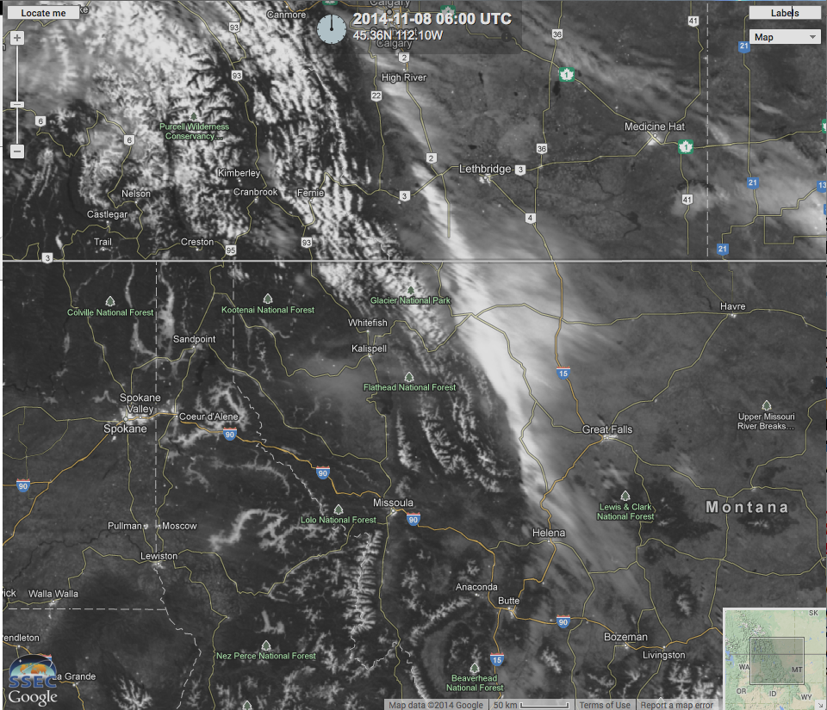
Identification of Fog at Night
Area Forecast Discussion
National Weather Service Missoula MT
334 AM MST SAT NOV 8 2014
…
.AVIATION...Moderate high pressure situated over the area will bring a chance for fog to develop at KGPI, KMSO and KSMN. The VIIRS night-time visible satellite image at 08/1010z revealed some valley fog across Clearwater County, Idaho and also north across the Idaho Panhandle. Any fog that develops near the aforementioned terminals will dissipate by noon. Expect light and variable surface winds at all the terminals.

Slide 26
Identifying Snowfall Extent
VIIRS high resolution visible band 6 September 2014
US National Weather Service Alaska Facebook Page

Slide 27
Looking ahead
Satellite Products transitioned to AWIPS II

Slide 28
NCEP Center Requirements Mission Priorities(1, 2 or 3)
Imagery | CPC | OPC | AWC | SPC
VIIRS Imagery Channel 1 | 1 | 1 | 1 | 3
VIIRS Imagery Channel 2 | 1 | 1 |  | 3
VIIRS Imagery Channel 3 |  | 1
VIIRS Imagery Channel 4 |  | 1 | 1
VIIRS Imagery Channel 5 |  | 1 | 1 | 3
VIIRS Imagery Moderate Channel 1 | 1 | 2 | 2
VIIRS Imagery Moderate Channel 5 |  | 2
VIIRS Imagery Moderate Channel 9 |  | 2
VIIRS Imagery Moderate Channel 13 |  | 2 |  | 3
VIIRS Imagery Moderate Channel 14 |  | 2 | 2
VIIRS Imagery Moderate Channel 16 | 1 | 2 | 2
VIIRS Imager Near Constant Contrast |  | 2 | 2
Snow, Ice and Hydrology | CPC | WPC | OPC
VIIRS Snow Cover Binary Map EDR | 3
VIIRS Snow Cover Fraction EDR | 3
Blended Snow Cover | 3
Snow Water Equivalent (ATMS) | 3 | 3
Sea Ice Characterization (VIIRS) | 2 |  | 2
Ice Surface Temperature [New] | 2 | 3 | 3
Blended Total Precipitable Water (ATMS) | 2 |  | 2
Blended Total Precipitable Water (GCOM) | 3
Blended Total Precipitable Water Anomaly | 3 |  | 2
Blended Total Precipitable Water Anomaly (GCOM) | 3
Blended Rainrate (ATMS) | 2
Blended Rain Rate (GCOM) | 2
Cloud Liquid Water (ATMS) | 3
Mapped MIRS Profiles |  | 1
MIRS Global RR Composite | 3 | 1
Atmospheric | CPC | WPC | OPC | AWC
Aerosol Optical Thickness | 3
Atmospheric Temperature Profile |  | 1
Suspended Matter |  |  |  | 1
Volcanic Ash | 2 |  | 1
Outgoing Longwave Radiation | 1
Ocean | CPC | OPC
Sea Surface Temperature (SST) | 1 | 1
Blended SST |  | 1
Ocean Color/Chlorophyll | 3 | 2
Harmful Algal Bloom Anomaly |  | 2
Chesapeake Bay Ocean Color |  | 2
Near Coast Ocean Color (SWIR) |  | 2
Ozone | CPC | WPC | OPC
Nadir Profile Ozone | 1
Ozone Total Column | 1 |  | 1
IR Ozone IP | 3
Limb Profile Ozone | 1
Blended Ozone | 1 | 2 | 2
Land | CPC | WPC
Active Fires | 3
Green Vegetation Fraction | 2
Land Surface Temperature (ATMS) | 3
Vegetation Index | 1
Land Surface Type | 2
Surface Albedo | 2
Land Surface Temperature (VIIRS) | 2 | 1
Vegetation Health Index | 2
Vegetation Moisture | 2 | 3
Mapped MIRS Surface Products |  | 1
Clouds | CPC | WPC | OPC
Cloud Cover/Layers (VIIRS) | 3 | 1 | 2
Cloud Mask (VIIRS) |  | 3
Cloud Liquid Water (ATMS) | 3
Cloud Top Temperature (VIIRS) | 3 | 1 | 1
Cloud Top Temperature (VIIRS) |  |  | 1
Cloud Top Pressure (VIIRS) |  | 3 | 2
Cloud Top Height (VIIRS) |  | 1 | 1
Cloud Base Height (VIIRS) | 3 | 1 | 1
Tropical Storms | CPC | OPC
Tropical Rainfall Potential | 2
Tropical Cyclone Intensity | 3 | 2
Complete
Currently not available

Slide 29
VIIRS Infrared Imagery AWIPS II National Centers Perspective

Slide 30
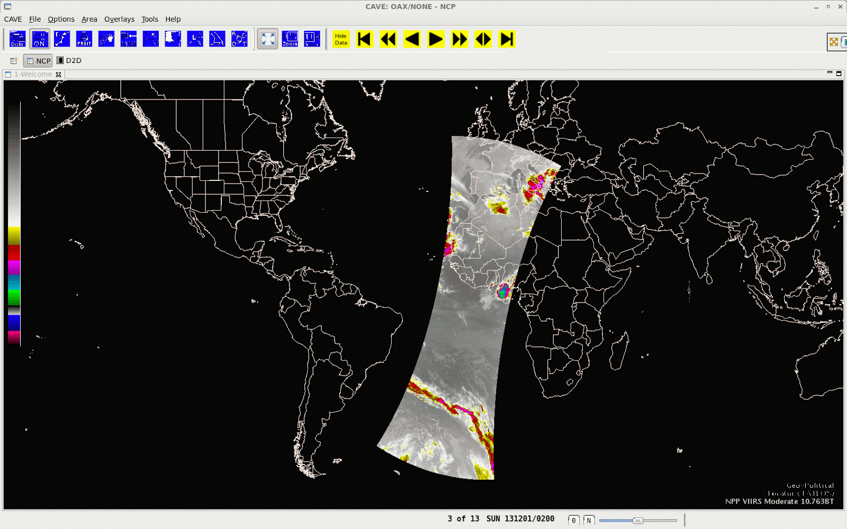
VIIRS Global Domain AWIPS II NCP

Slide 31
VIIRS DNB in AWIPS-II 23 June 2014

Slide 32
NUCAPS AWIPS II D2D

Slide 33
NUCAPS AWIPS II D2D

Slide 34
Future Work
Testing capabilities of NCP to handle AREA files using the McIDAS Plug-in
Had issues with projection (rectilinear was not supported until recently)
RGB Working Group will continue to investigate NCP capabilities to create RGBs “on the fly”.
Will continue to work with the AWIPS II testbed with another site visit in Spring 2015.

Slide 35
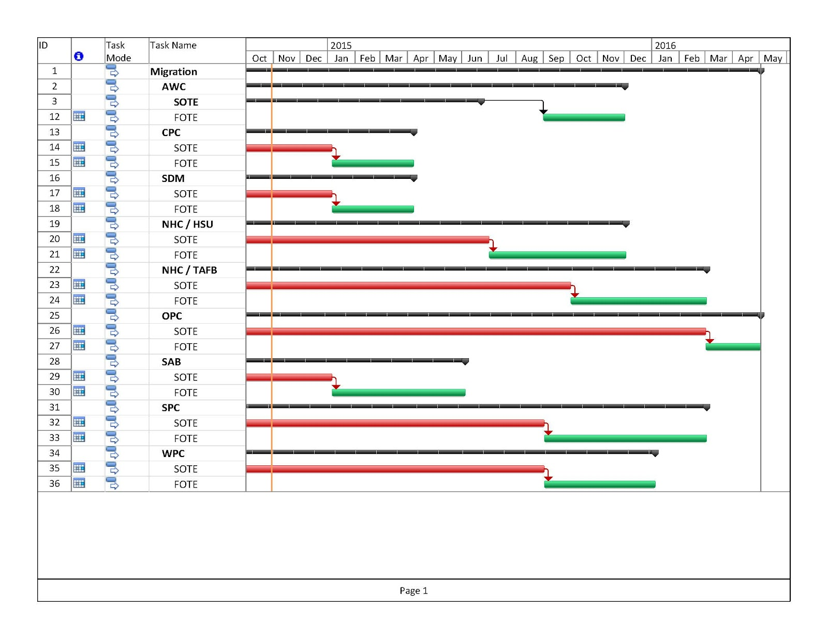
NCEP AWIPS II Roll-Out

Slide 36
Questions? michael.folmer@noaa.gov
Hurricane Michael (2012)

